Slide 1
Efficient Implementation of Classic McEliece on ARMv8 processors
https://youtu.be/F7tl64gWfIU

Slide 2
Introduction
With the development of quantum computers, classic cryptography algorithms are facing threats.
In preparation for the quantum computer threat, NIST initiated the Post-Quantum Cryptography standardization.
The Classic McEliece was selected as one of the Round 4 candidate algorithms.
In this paper, we proposed efficient implementation of Classic McEliece.
Optimized implementation of multiplier.

Slide 3
Our Contribution
Multiplication with Parallel Operations on ARMv8 Processors.
Reordering the order of operations using the XOR operation.
Utilize vector registers to perform four values parallel operations.
The first implementation of Classic McEliece multiplier on ARMv8 processors using vector registers.
It might be helpful to following researchers.

Slide 4
Background: Classic McEliece
Code-based cryptography.
Round 4 candidate algorithms : BIKE, Classic McEliece, HQC, SIKE
Classic McEliece is designed to combine the advantages of McEliece and Niederreiter cryptosystem.
Using the Parity Check Matrix(H) used as the public key in Niederreiter cryptosystem.

Slide 5
Background: Classic McEliece
It has a very short ciphertext length, and encryption and decryption are possible in a short time.
However, the length of the public key is very large.
256KB to 1.3MB range
The key generation process is slow.
Algorithm | m | n | t | Security level | Public key | Secret key | Ciphertext
Mceliece 348864 | 12 | 3,488 | 64 | 1 | 261,120 | 6,492 | 128
Mceliece 460896 | 13 | 4,608 | 86 | 3 | 524,160 | 13,608 | 188
Mceliece 6688128 | 13 | 6,688 | 128 | 5 | 1,044,992 | 13,932 | 240
Mceliece 6960119 | 13 | 6,960 | 119 | 5 | 1,047,319 | 13,948 | 226
Mceliece 8192128 | 13 | 8,192 | 128 | 5 | 1,357,824 | 14,120 | 240
Table 1. Parameters of Classic McEliece.

Slide 6
Background: 64-bit ARMv8 Processor
Widely used high-performance processors.
Support both 32-bit AArch32 and 64-bit AArch64 architectures.
Provide 64-bit ARM & 128-bit vector registers and instruction sets.
64-bit general-purpose registers from x0 to x30.
128-bit vector registers from v0 to v31.
Parallel implementation using vector instructions.

Slide 7
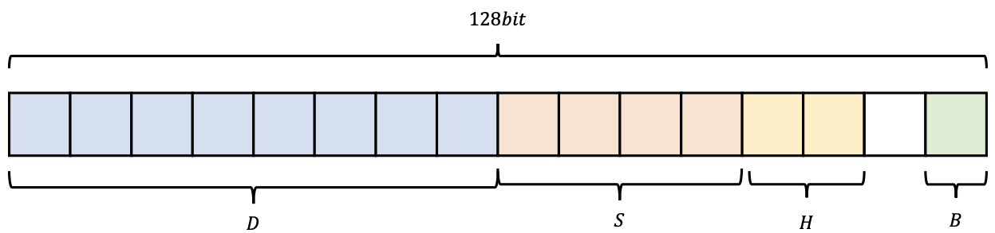
Background: 64-bit ARMv8 Processor
The vector registers can be processed by dividing stored values into specific units.
: Byte (8-bit), Half word (16-bit), Single word (32-bit), and Double word (64-bit)
Arrangement specifiers belong to instructions.
Operational units can be changed by specifiers of instructions.

Slide 8
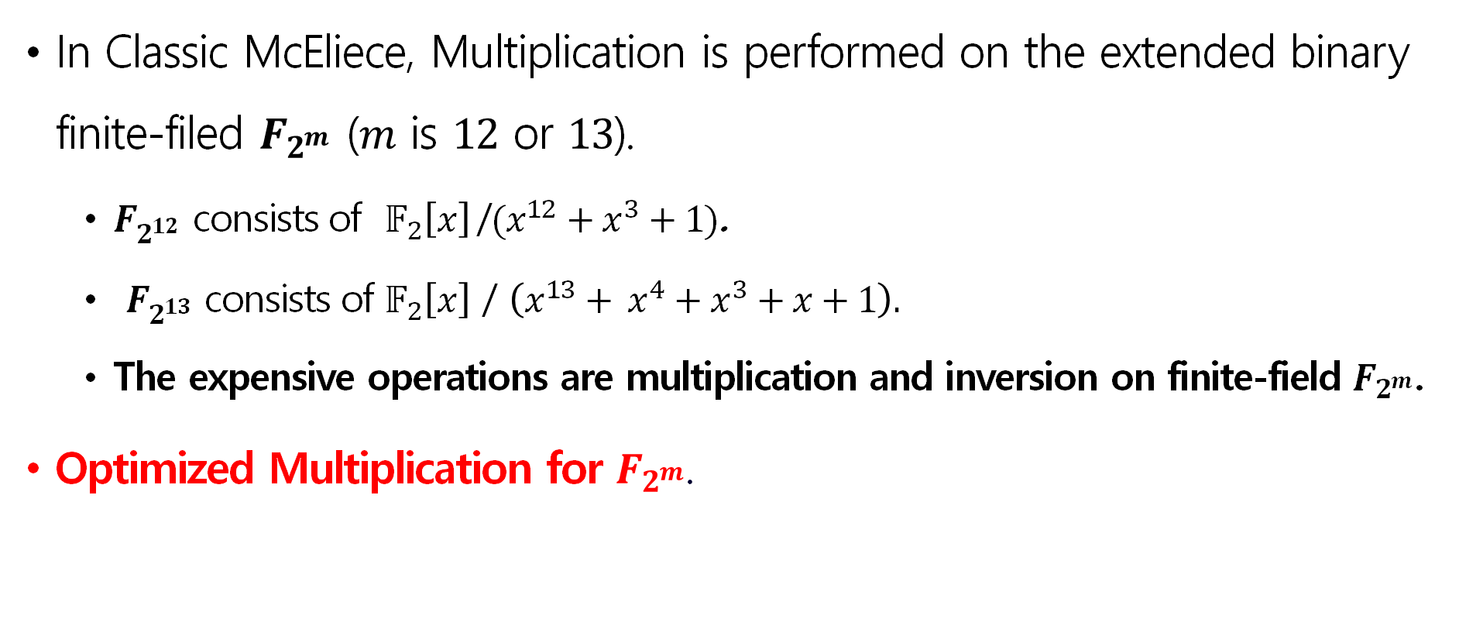
Proposed Method
In Classic McEliece, Multiplication is performed on the extended binary finite-filed $F_{2^{m}}$ ($m$ is $12$ or $13$).
$F_{2^{12}}$ consists of $𝔽_{2}\left[x\right]$/$(x^{12}+x^{3}+1)$.
$F_{2^{13}}$ consists of $𝔽_{2}\left[x\right]$ / $\left(x^{13}+ x^{4}+x^{3}+x+1\right).$
The expensive operations are multiplication and inversion on finite-field $F_{2^{m}}$.
Optimized Multiplication for $F_{2^{m}}$.

Slide 9
Proposed Method
We proposed Multiplication with Parallel Operations.
Optimization techniques :
Apply masking operation for multiplication.
Parallel multiplier using reordering of operations.
Utilize vector registers to perform four values parallel operations.

Slide 10
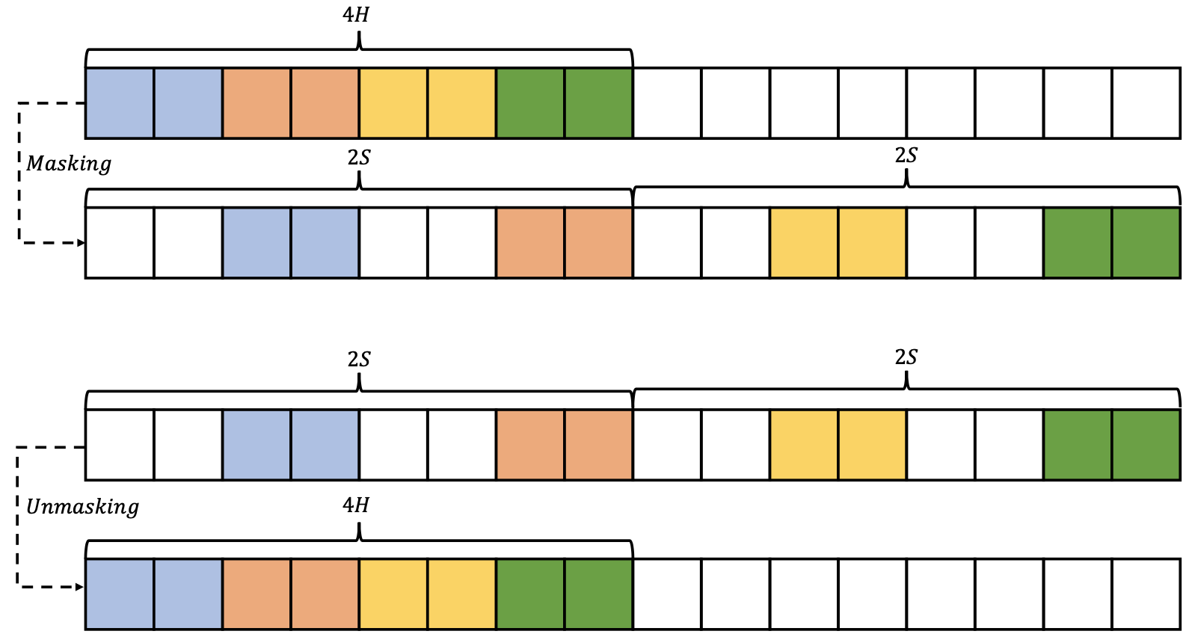
Proposed Method
Masking & Unmasking operation

Slide 11
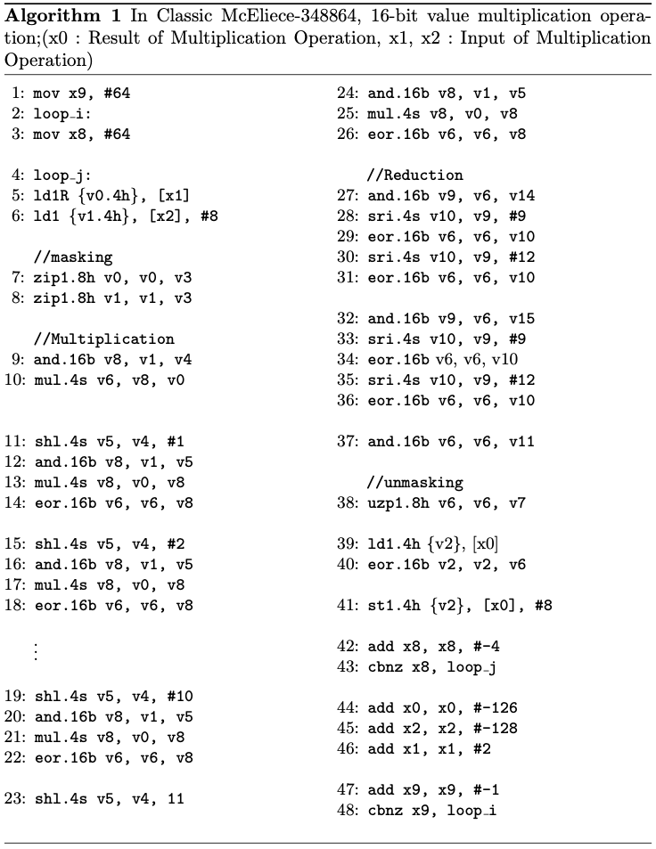
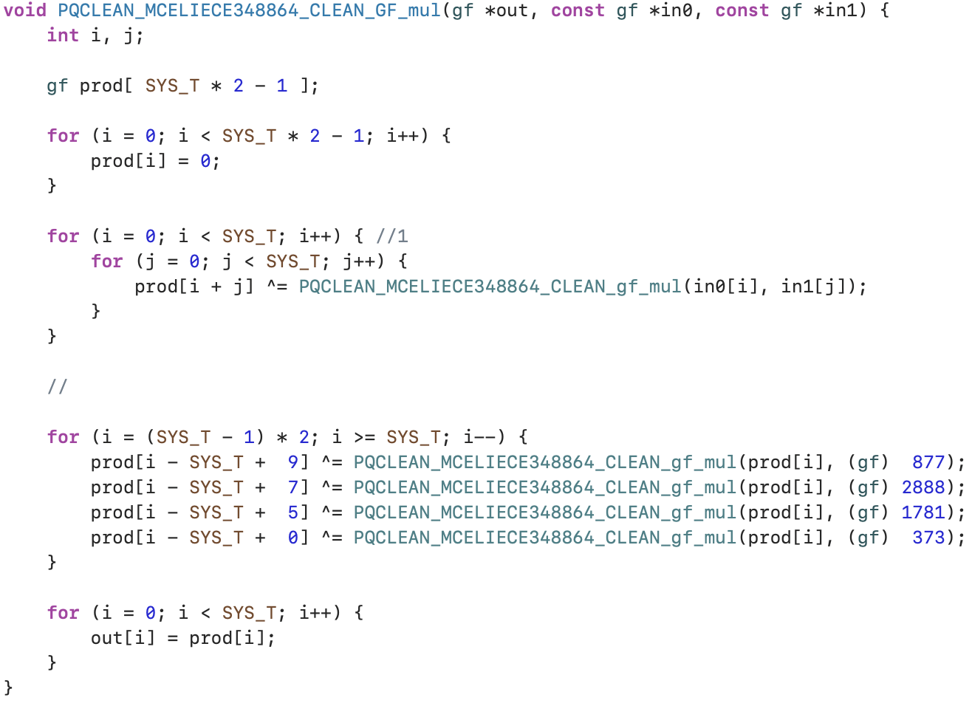
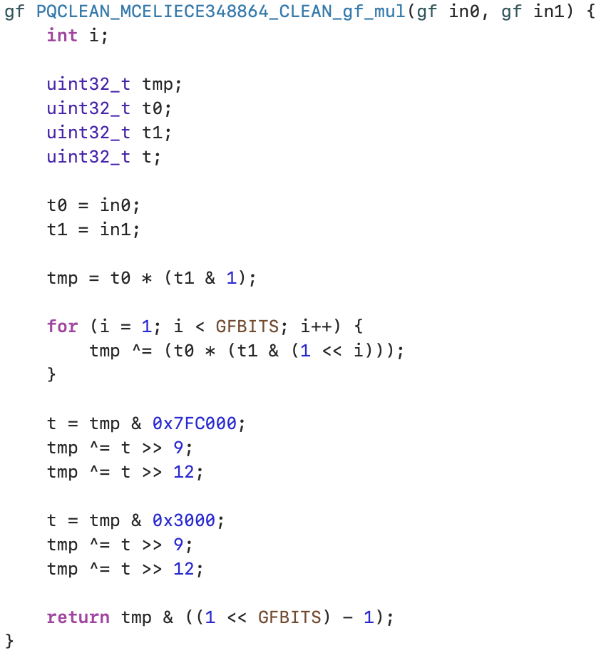

Proposed Method
Optimization implementation code for multiplication on $F_{2^{m}}$.
Written by ARM assembly.

Slide 12
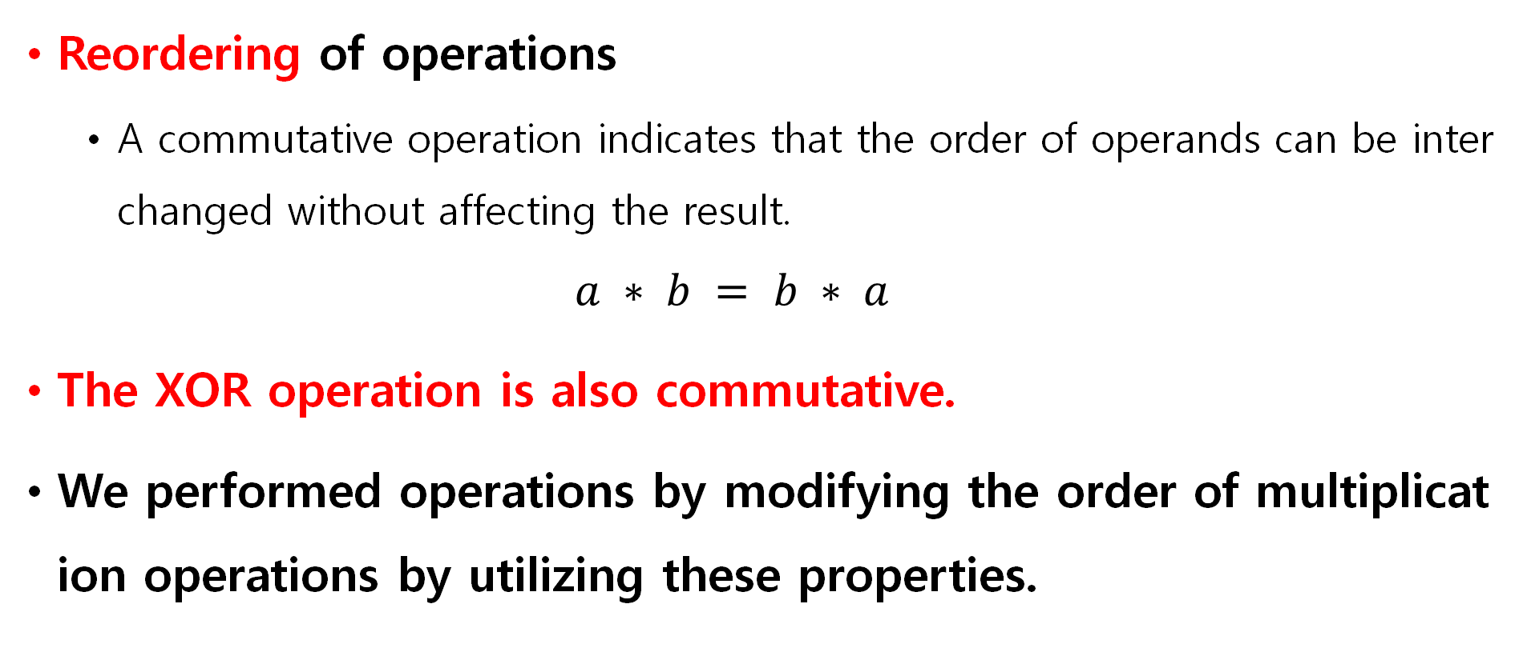
Proposed Method
Reordering of operations
A commutative operation indicates that the order of operands can be interchanged without affecting the result.
$$a ∗ b = b ∗ a$$
The XOR operation is also commutative.
We performed operations by modifying the order of multiplication operations by utilizing these properties.

Slide 13
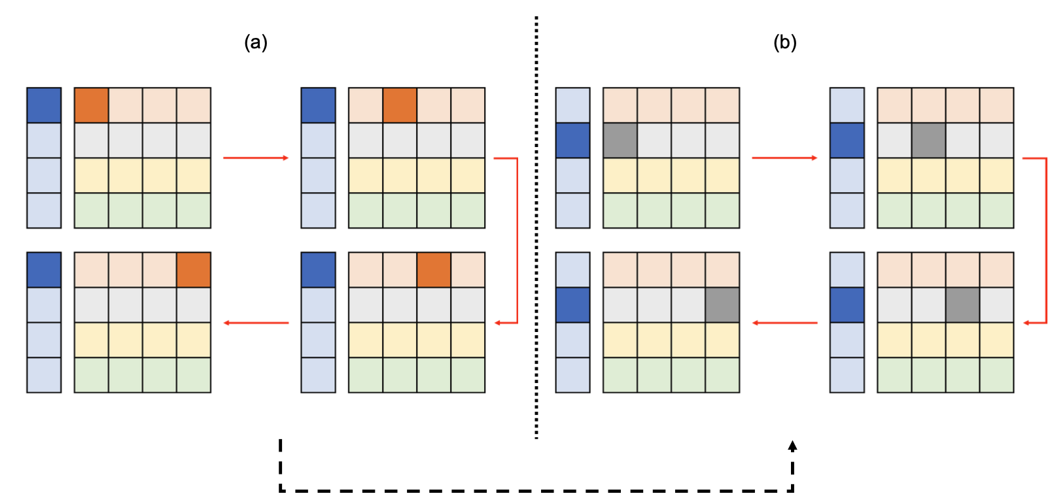
Proposed Method
Represent the original order of multiplication operations performed.
Once the operations depicted in (a) are completed, the multiplication computations proceed in the order presented in (b).

Slide 14
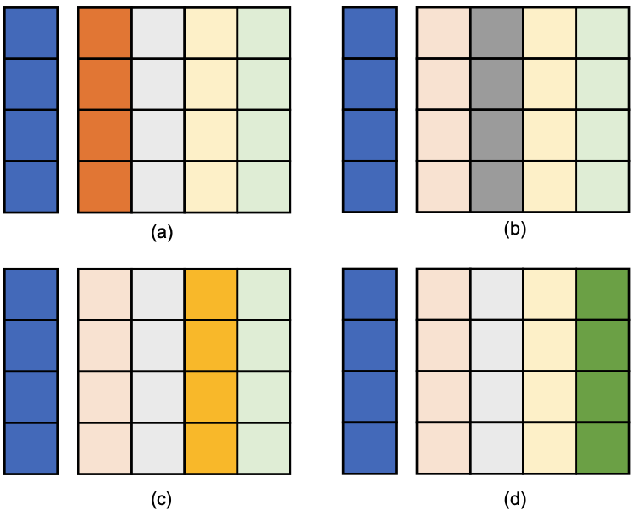
Proposed Method
Sequence of proposed order of multiplication operation using four 16-bit loaded vector registers.

Slide 15
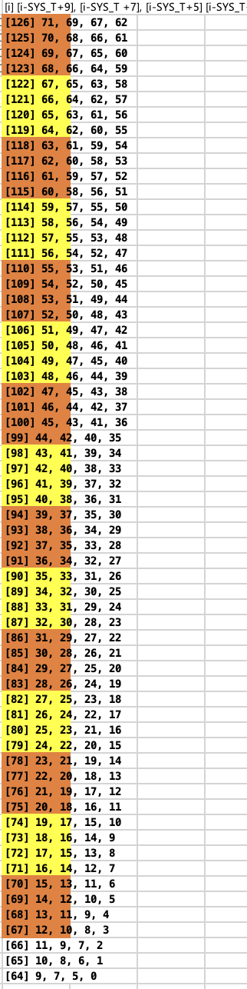
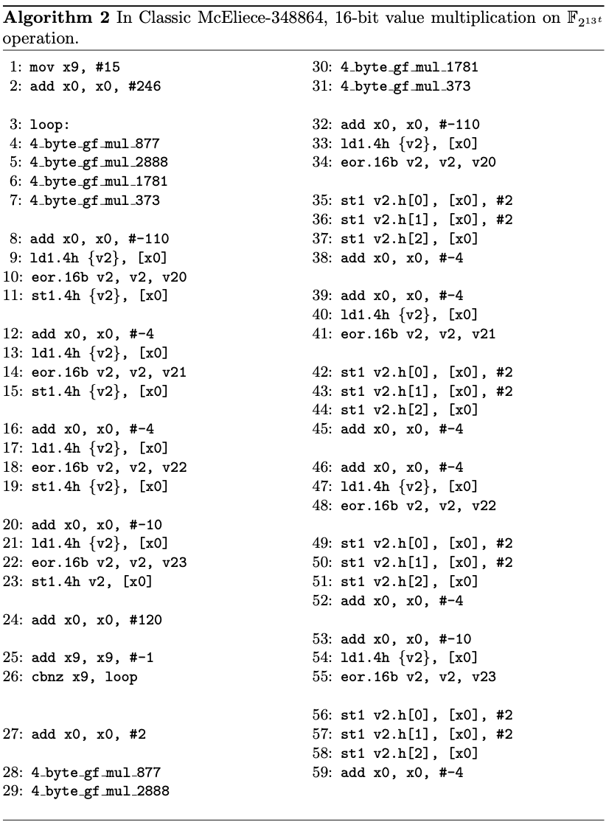

Proposed Method
Part of the optimization implementation code on $F_{2^{13t}}$.
Written by ARM assembly.

Slide 16
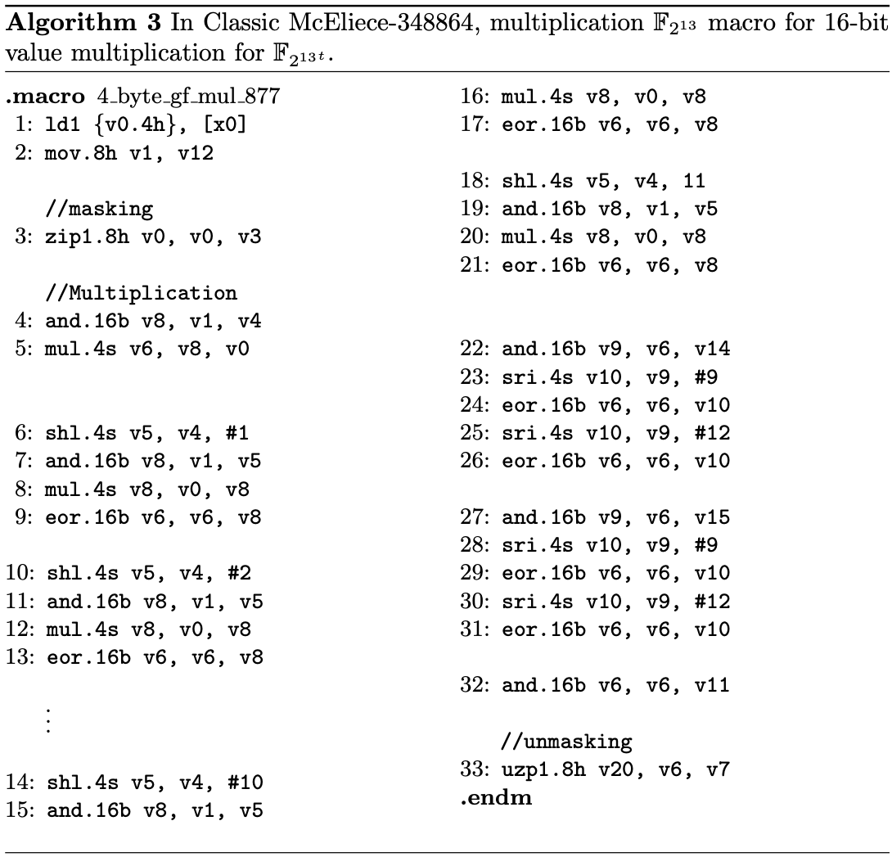
Proposed Method
One of the macros used by Algorithm 2.
Perform the load for four 16 bits and performs one masking process over one whole.

Slide 17

Evaluation
Implementation Environment
Target Processor: Apple Macbook Pro 13 with Apple M1 chip (3.2GHz)
Framework: Xcode Integrated Development Environment
Compiled with -O2 option(i.e. faster)
Assessment Methods
Since ARMv8 does not have a Classic McEliece implementation,
the performance is compared with the PQ-Clean project reference code.
Multiplier was repeated by 1,000,000 times to measure the operation time.

Slide 18
Evaluation
Performance enhancement of up to 2.82× compared to the reference implementation.
Scheme | Unit | PQ-Clean | This Work | Improvement
Classic McEliece 348864 | ms | 4,294 | 5,429 | 0.79x
 | cc | 13,740 | 17,372
Classic McEliece 460896 | ms | 40,579 | 14,563 | 2.79x
 | cc | 129,852 | 46,601
Classic McEliece 6699128 | ms | 71,185 | 25,343 | 2.80x
 | cc | 227,792 | 81,097
Classic McEliece 6960119 | ms | 61,690 | 21,972 | 2.81x
 | cc | 197,408 | 70,310
Classic McEliece 819212 | ms | 71,193 | 25,222 | 2.82x
 | cc | 227,817 | 80,710

Slide 19
Conclusion
We proposed parallel multiplier of Classic McEliece.
Optimized implementation version on ARM processors.
Method of proposed parallel multiplication.
Reordering the order of operations.
Utilize vector registers to perform four values parallel operations.
It showed a performance improvement of up to 2.84 times.

